Slide 1
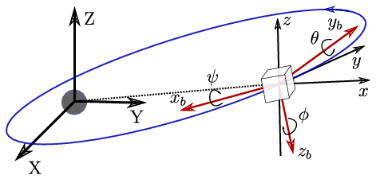
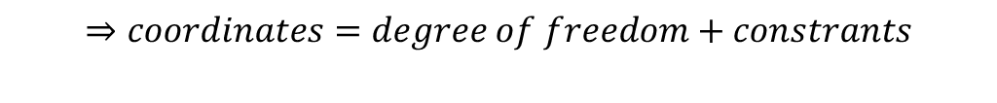
Course I: Kinematics: Describing the Motions of spacecraft
1. Performed Attitude Method
The orientation of the body frame with respect to the reference frame is given by satellite's attitude.
This orientation is represented by a proper orthogonal matrix called as rotation matrix or attitude matrix.
A minimum of three coordinates is required to describe the relative angular displacement between two reference frames.
$$⇒coordinates=degree of freedom+constrants$$

Slide 2
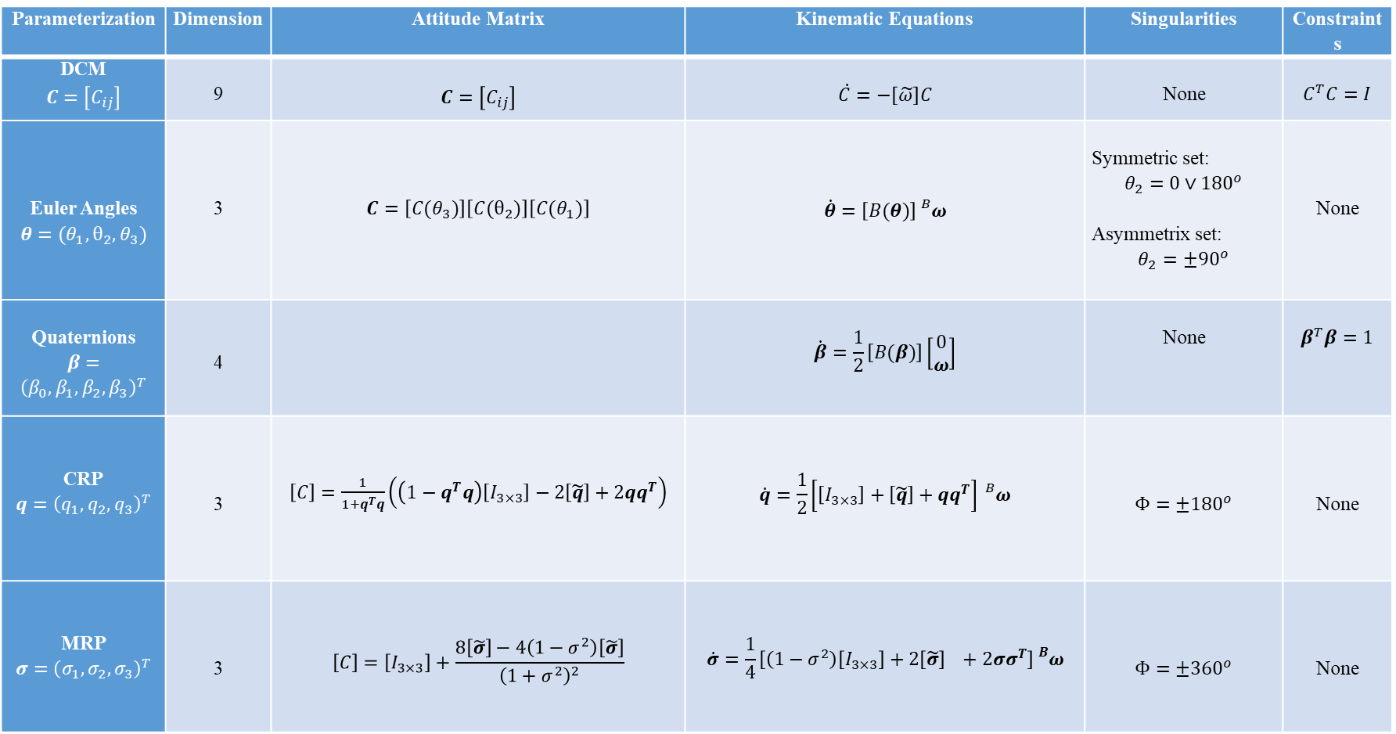
Course I: Kinematics: Describing the Motions of spacecraft
Parameterization | Dimension | Attitude Matrix | Kinematic Equations | Singularities | Constraints
DCM $$C=\left[C_{ij}\right]$$ | 9 | $$C=\left[C_{ij}\right]$$ | $$\dot{C}=−\left[\tilde{ω}\right]C$$ | None | $$C^{T}C=I$$
Euler Angles $$θ=(θ_{1},θ_{2},θ_{3})$$ | 3 | $$C=\left[C(θ_{3})\right]\left[C(θ_{2})\right]\left[C(θ_{1})\right]$$ | $$\dot{θ}=\left[B(θ)\right]{}_{}^{B}ω$$ | Symmetric set: $$θ_{2}=0∨{180}^{o}$$ Asymmetrix set: $$θ_{2}=±{90}^{o}$$ | None
Quaternions $$β=$$ $${\left(β_{0},β_{1},β_{2},β_{3}\right)}^{T}$$ | 4 |  | $$\dot{β}=\frac{1}{2}\left[B(β)\right]\left[\begin{matrix}0 \\ ω\end{matrix}\right]$$ | None | $$β^{T}β=1$$
CRP $$q={\left(q_{1},q_{2},q_{3}\right)}^{T}$$ | 3 | $\left[C\right]=\frac{1}{1+q^{T}q}\left(\left(1−q^{T}q\right)\left[I_{3×3}\right]−2\left[\tilde{q}\right]+2qq^{T}\right)$ | $$\dot{q}=\frac{1}{2}\left[\left[I_{3×3}\right]+\left[\tilde{q}\right]+qq^{T}\right]{}_{}^{B}ω$$ | $$Φ=±{180}^{o}$$ | None
MRP $$σ={\left(σ_{1},σ_{2},σ_{3}\right)}^{T}$$ | 3 | $$\left[C\right]=\left[I_{3×3}\right]+\frac{8\left[\tilde{σ}\right]−4\left(1−σ^{2}\right)\left[\tilde{σ}\right]}{{\left(1+σ^{2}\right)}^{2}}$$ | $$\dot{σ}=\frac{1}{4}\left[\left(1−σ^{2}\right)\left[I_{3×3}\right]+2\left[\tilde{σ}\right] +2σσ^{T}\right]{}_{}^{B}ω$$ | $$Φ=±{360}^{o}$$ | None

Slide 3
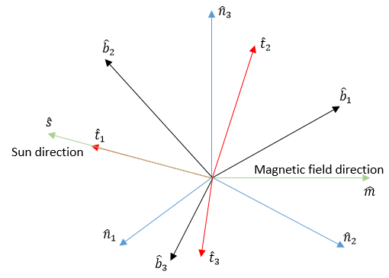
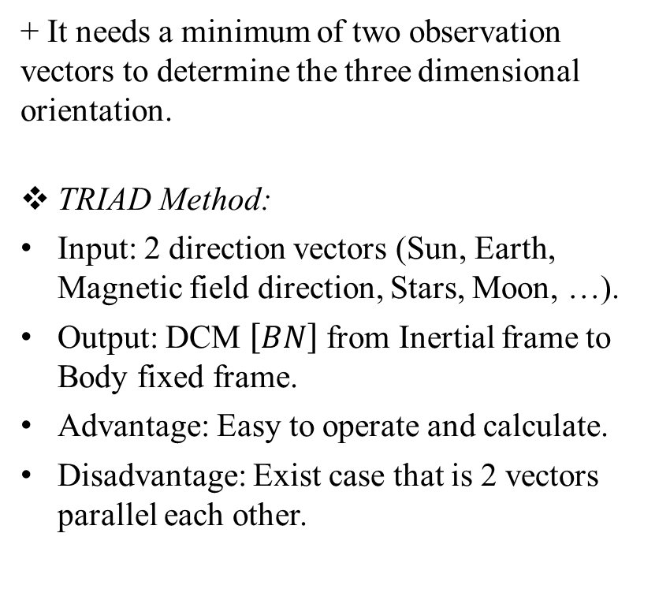
Course I: Kinematics: Describing the Motions of spacecraft
2. Attitude Determination:
+ It needs a minimum of two observation vectors to determine the three dimensional orientation.
TRIAD Method:
Input: 2 direction vectors (Sun, Earth, Magnetic field direction, Stars, Moon, …).
Output: DCM $\left[BN\right]$ from Inertial frame to Body fixed frame.
Advantage: Easy to operate and calculate.
Disadvantage: Exist case that is 2 vectors parallel each other.

Slide 4
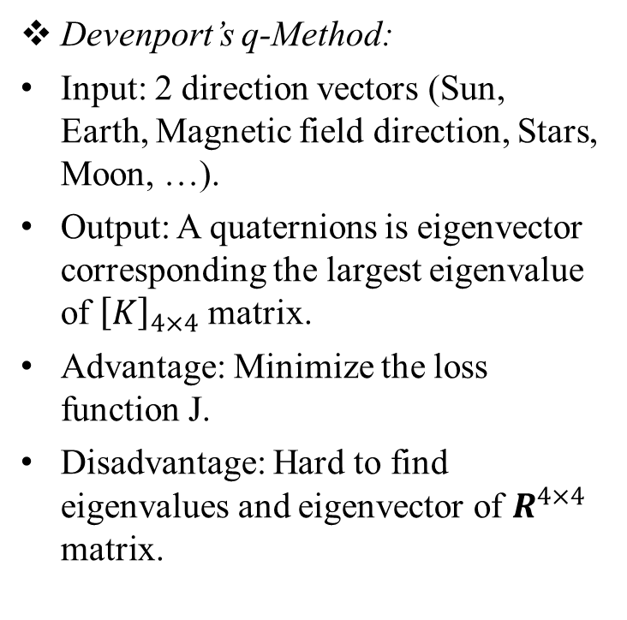
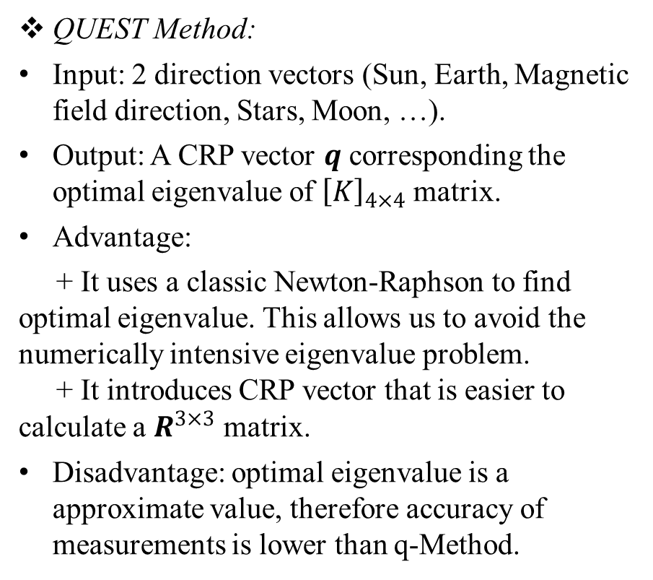
Course I: Kinematics: Describing the Motions of spacecraft
Wahba’s Problem:
+ Evaluate the measurements by loss function: $J\left(\left[\overline{B}N\right]\right)=\frac{1}{2}\sum_{k=1}^{N}{ω_{k}{\left|{}_{}^{B}{{\hat{v}}_{k}−\left[\overline{B}N\right]{}_{ }^{N}{{\hat{v}}_{k}}}\right|}^{2}}$
Devenport’s q-Method:
Input: 2 direction vectors (Sun, Earth, Magnetic field direction, Stars, Moon, …).
Output: A quaternions is eigenvector corresponding the largest eigenvalue of ${\left[K\right]}_{4×4}$ matrix.
Advantage: Minimize the loss function J.
Disadvantage: Hard to find eigenvalues and eigenvector of $R^{4×4}$ matrix.
QUEST Method:
Input: 2 direction vectors (Sun, Earth, Magnetic field direction, Stars, Moon, …).
Output: A CRP vector $q$ corresponding the optimal eigenvalue of ${\left[K\right]}_{4×4}$ matrix.
Advantage:
+ It uses a classic Newton-Raphson to find optimal eigenvalue. This allows us to avoid the numerically intensive eigenvalue problem.
+ It introduces CRP vector that is easier to calculate a $R^{3×3}$ matrix.
Disadvantage: optimal eigenvalue is a approximate value, therefore accuracy of measurements is lower than q-Method.

Slide 5
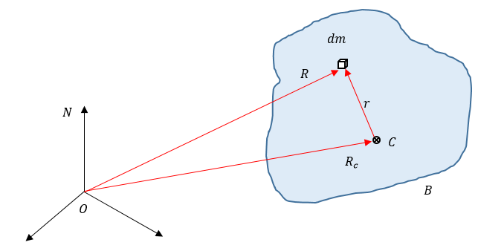
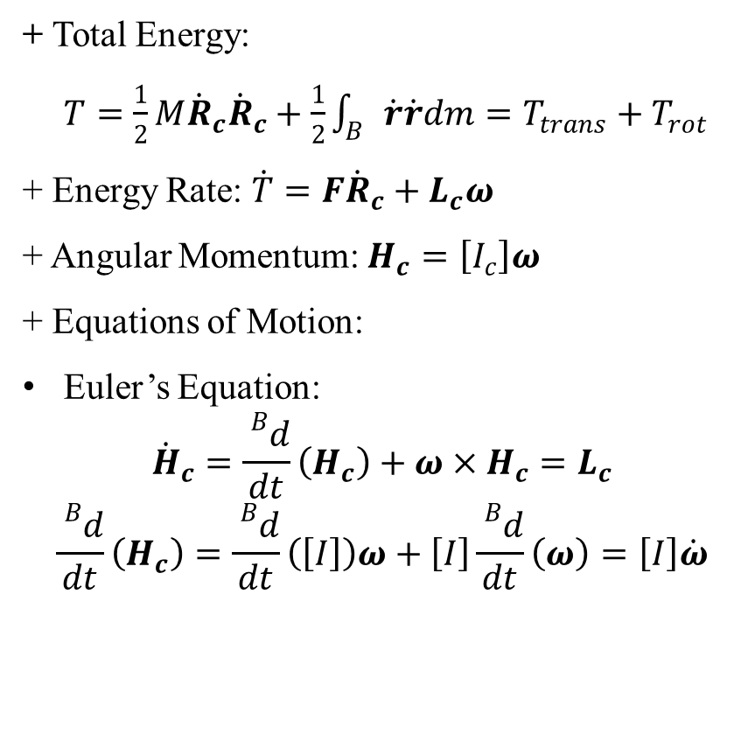
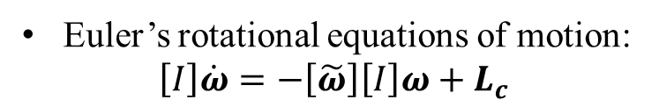
Course II: Kinetics: Study Spacecraft Motion
1. Rigid Body Dynamics:
+ Total Energy:
$T=\frac{1}{2}M{\dot{R}}_{c}{\dot{R}}_{c}+\frac{1}{2}\int_{B}{\dot{r}\dot{r}dm}=T_{trans}+T_{rot}$
+ Energy Rate: $\dot{T}=F{\dot{R}}_{c}+L_{c}ω$
+ Angular Momentum: $H_{c}=\left[I_{c}\right]ω$
+ Equations of Motion:
Euler’s Equation:
$${\dot{H}}_{c}=\frac{{}_{}^{B}d}{dt}\left(H_{c}\right)+ω×H_{c}=L_{c}$$
$$\frac{{}_{}^{B}d}{dt}\left(H_{c}\right)=\frac{{}_{}^{B}d}{dt}\left(\left[I\right]\right)ω+\left[I\right]\frac{{}_{}^{B}d}{dt}\left(ω\right)=\left[I\right]\dot{ω}$$
Euler’s rotational equations of motion:
$$\left[I\right]\dot{ω}=−\left[\tilde{ω}\right]\left[I\right]ω+L_{c}$$

Slide 6
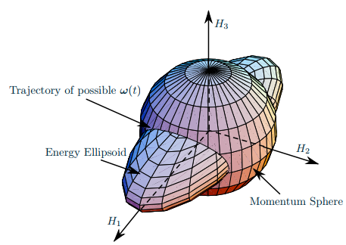
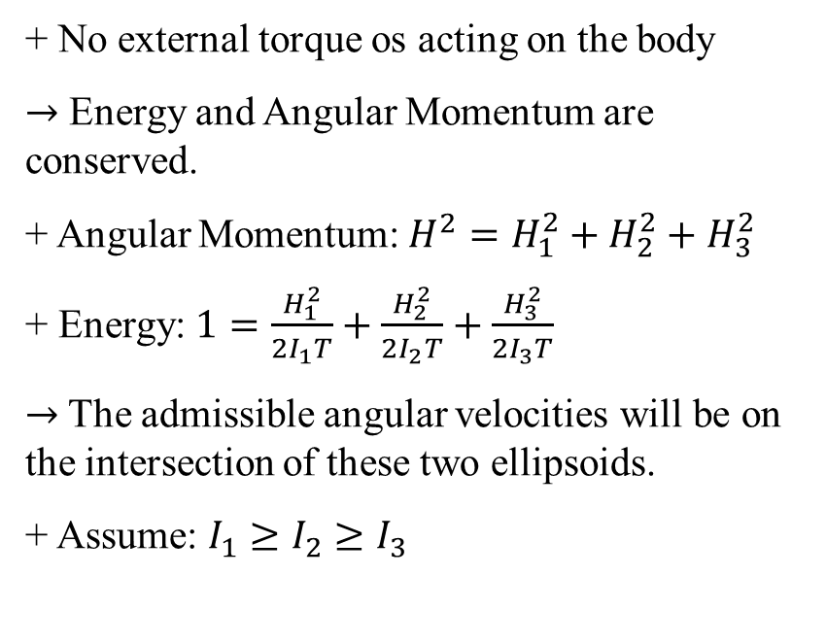
Course II: Kinetics: Study Spacecraft Motion
2. Momentum/Energy Surface:
+ No external torque os acting on the body
$→$ Energy and Angular Momentum are conserved.
+ Angular Momentum: $H^{2}=H_{1}^{2}+H_{2}^{2}+H_{3}^{2}$
+ Energy: $1=\frac{H_{1}^{2}}{2I_{1}T}+\frac{H_{2}^{2}}{2I_{2}T}+\frac{H_{3}^{2}}{2I_{3}T}$
$→$The admissible angular velocities will be on the intersection of these two ellipsoids.
+ Assume: $I_{1}≥I_{2}≥I_{3}$

Slide 7
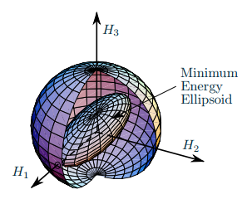
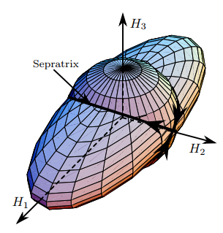
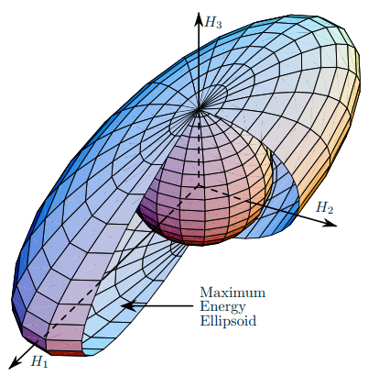
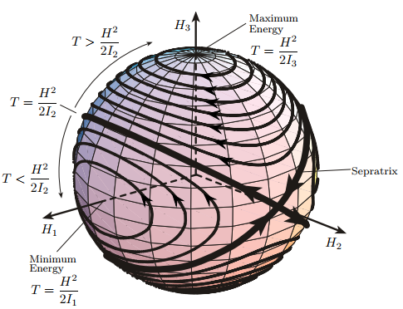
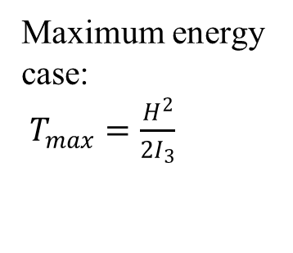
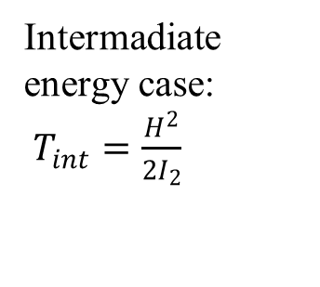
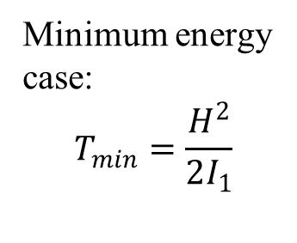
Course II: Kinetics: Study Spacecraft Motion
Minimum energy
case:
$$T_{min}=\frac{H^{2}}{2I_{1}}$$
Intermadiate energy case:
$T_{int}=\frac{H^{2}}{2I_{2}}$
Maximum energy
case:
$T_{max}=\frac{H^{2}}{2I_{3}}$
Family of energy ellipsoid and momentum sphere intersections.

Slide 8
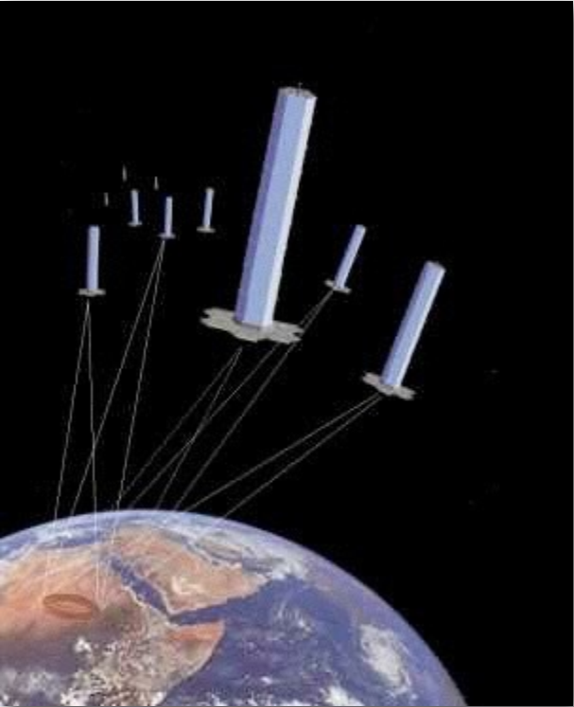
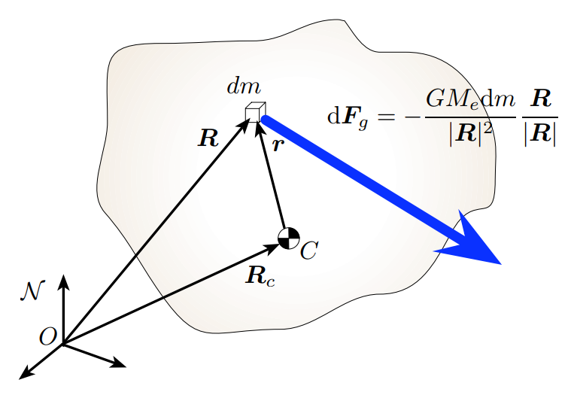
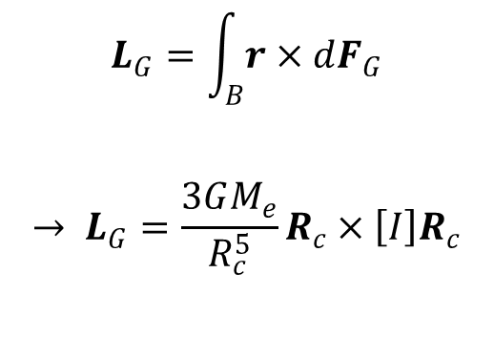
Course II: Kinetics: Study Spacecraft Motion
3. Gravity Gradient:
+ Because of gravity gradient, the “lower” parts of the body will be heavier than the “upper” parts.
+ The gravity gradient torque acting on the spacecraft is:
$$L_{G}=\int_{B}^{ }{r×dF_{G}}$$
$$→ L_{G}=\frac{3GM_{e}}{R_{c}^{5}}R_{c}×\left[I\right]R_{c}$$

Slide 9
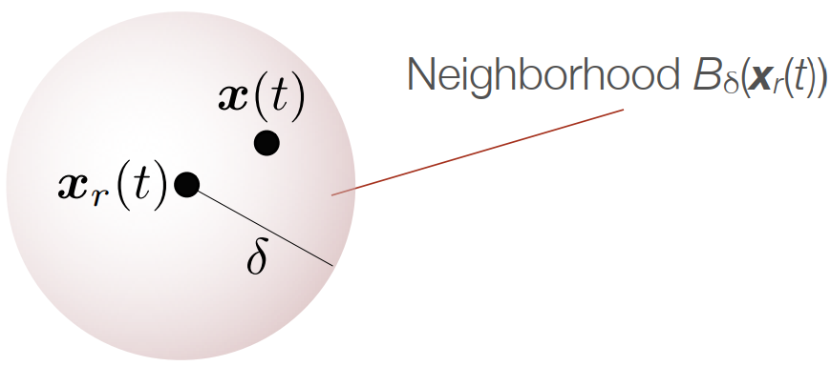
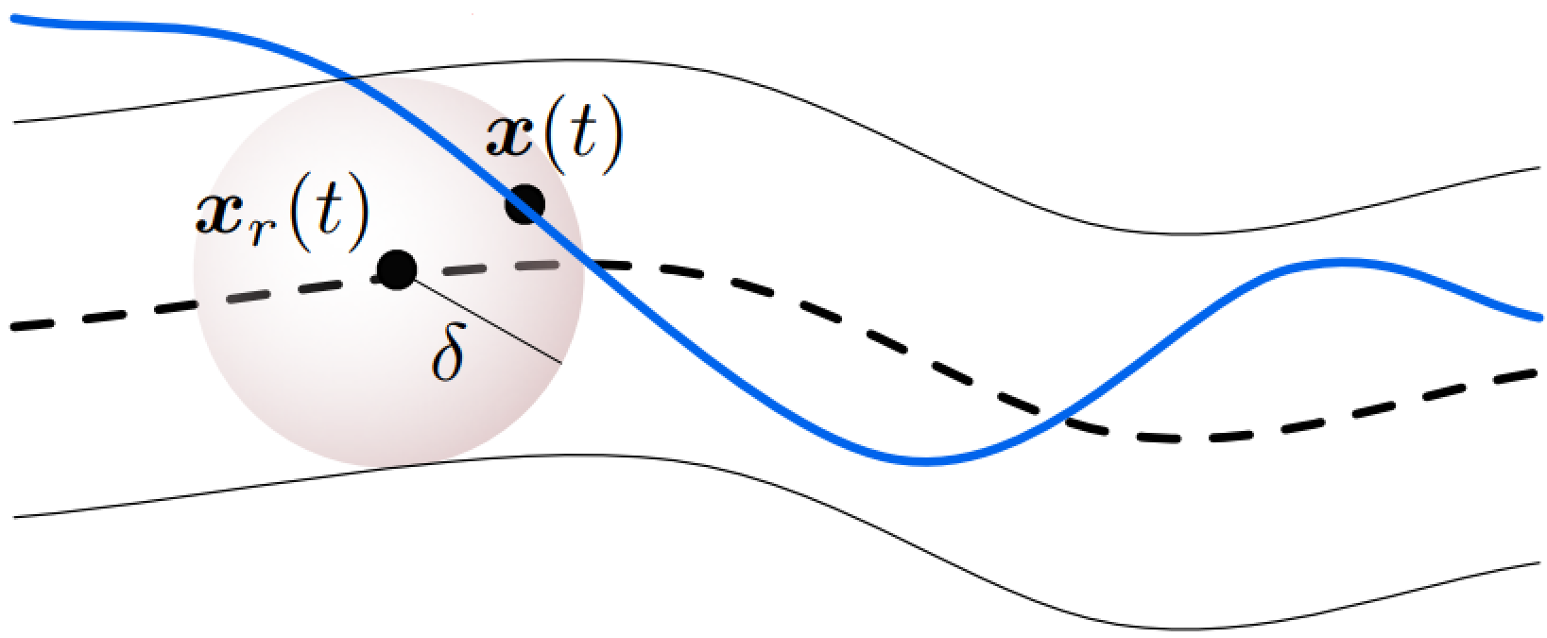
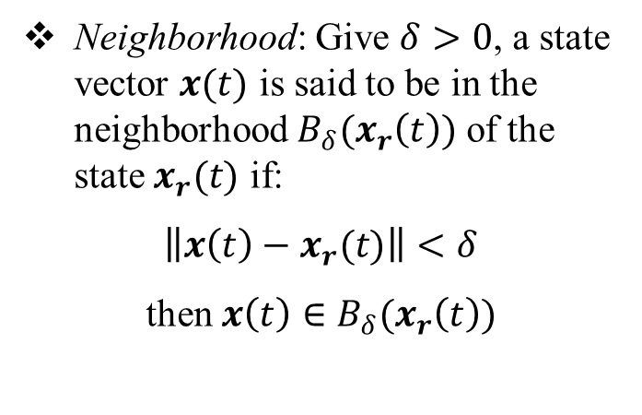
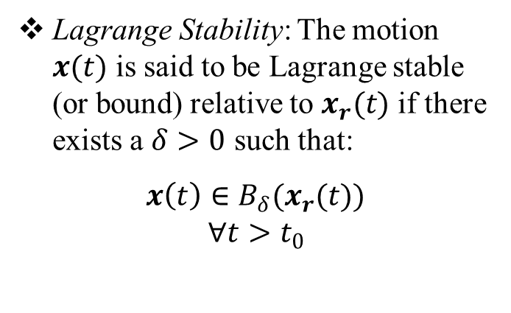
Course III: Control of Nonlinear Spacecraft Attitude Motion
1. Stability Definitions:
Neighborhood: Give $δ>0$, a state vector $x(t)$ is said to be in the neighborhood $B_{δ}(x_{r}\left(t\right))$ of the state $x_{r}(t)$ if:
$\left\|x\left(t\right)−x_{r}(t)\right\|<δ$
then $x\left(t\right)∈B_{δ}(x_{r}\left(t\right))$
Lagrange Stability: The motion $x(t)$ is said to be Lagrange stable (or bound) relative to $x_{r}(t)$ if there exists a $δ>0$ such that:
$x\left(t\right)∈B_{δ}(x_{r}(t))$
$$∀t>t_{0}$$

Slide 10
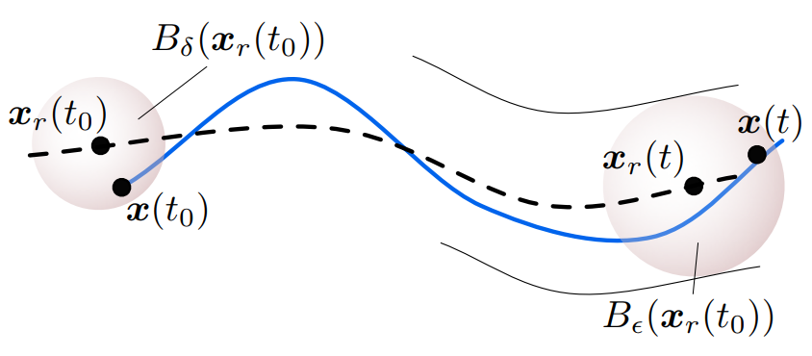
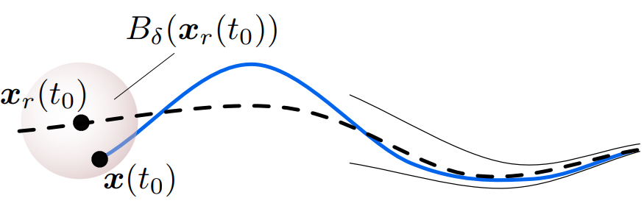
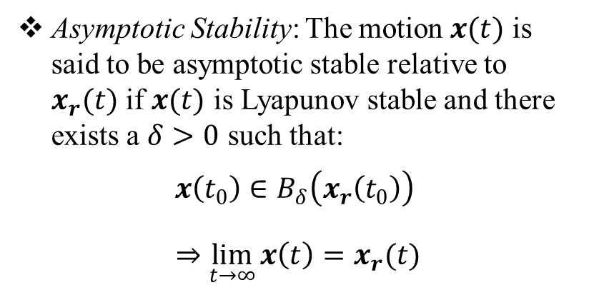
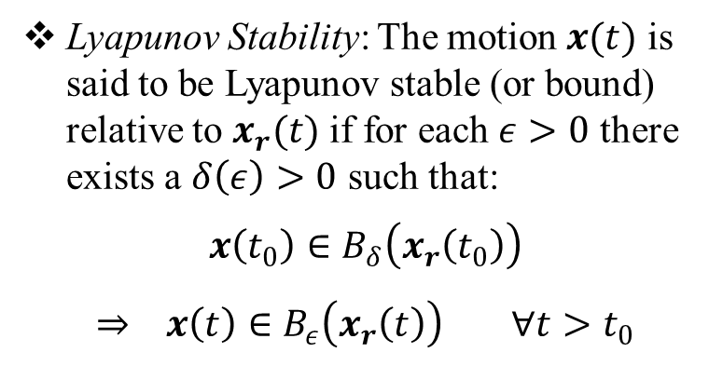
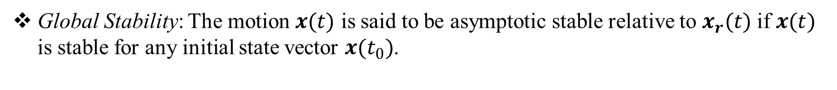
Course III: Control of Nonlinear Spacecraft Attitude Motion
Lyapunov Stability: The motion $x(t)$ is said to be Lyapunov stable (or bound) relative to $x_{r}(t)$ if for each $ε>0$ there exists a $δ\left(ε\right)>0$ such that:
$$x\left(t_{0}\right)∈B_{δ}\left(x_{r}\left(t_{0}\right)\right)$$
$$⇒ x\left(t\right)∈B_{ε}\left(x_{r}\left(t\right)\right) ∀t>t_{0}$$
Asymptotic Stability: The motion $x(t)$ is said to be asymptotic stable relative to $x_{r}(t)$ if $x(t)$ is Lyapunov stable and there exists a $δ>0$ such that:
$$x\left(t_{0}\right)∈B_{δ}\left(x_{r}\left(t_{0}\right)\right)$$
$$⇒\lim_{t→∞}{x\left(t\right)=x_{r}(t)}$$
Global Stability: The motion $x(t)$ is said to be asymptotic stable relative to $x_{r}(t)$ if $x(t)$ is stable for any initial state vector $x(t_{0})$.

Slide 11
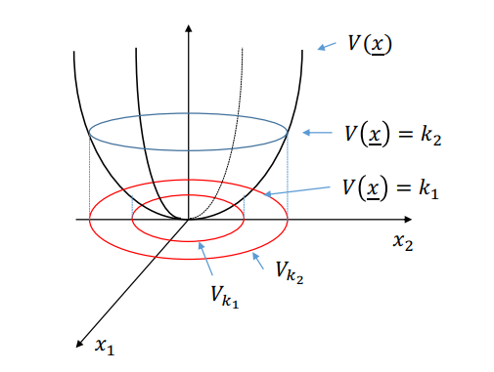
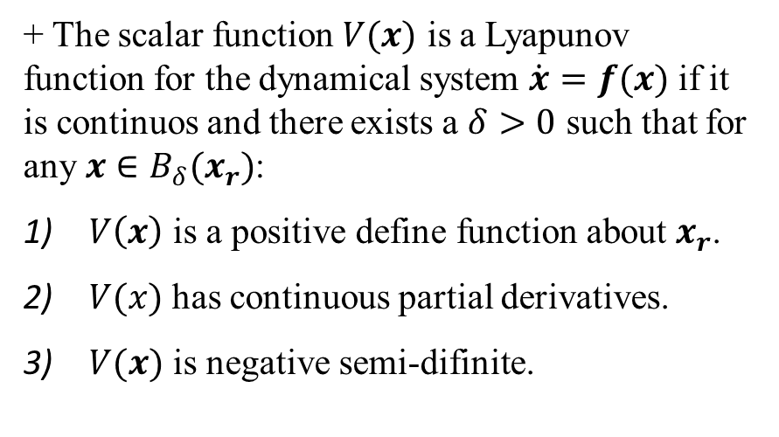
Course III: Control of Nonlinear Spacecraft Attitude Motion
2. Lyapunov Function:
+ The scalar function $V(x)$ is a Lyapunov function for the dynamical system $\dot{x}=f(x)$ if it is continuos and there exists a $δ>0$ such that for any $x∈B_{δ}(x_{r})$:
$V\left(x\right)$ is a positive define function about $x_{r}$.
$V(x)$ has continuous partial derivatives.
$V(x)$ is negative semi-difinite.

Slide 12
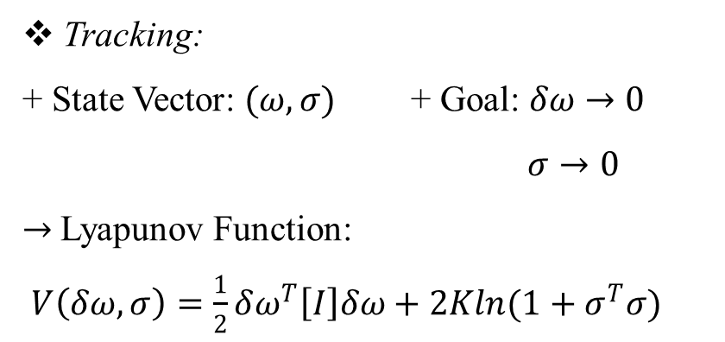
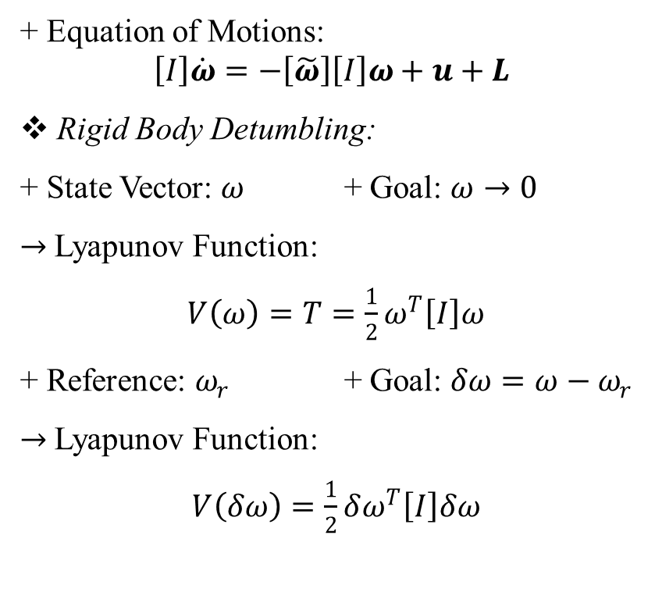
Course III: Control of Nonlinear Spacecraft Attitude Motion
3. Lyapunov Function for Difference Goal:
+ Equation of Motions:
$$\left[I\right]\dot{ω}=−\left[\tilde{ω}\right]\left[I\right]ω+u+L$$
Rigid Body Detumbling:
+ State Vector: $ω$ + Goal: $ω→0$
$→$Lyapunov Function:
$V\left(ω\right)=T=\frac{1}{2}ω^{T}\left[I\right]ω$
+ Reference: $ω_{r}$ + Goal: $δω=ω−ω_{r}$
$→$Lyapunov Function:
$V\left(δω\right)=\frac{1}{2}δω^{T}\left[I\right]δω$
Tracking:
+ State Vector: $(ω,σ)$ + Goal: $δω→0$
$σ→0$
$→$Lyapunov Function:
$V\left(δω,σ\right)=\frac{1}{2}δω^{T}\left[I\right]δω+2Kln(1+σ^{T}σ)$

